Slide 1







Stack Overflow Developer Survey: 2019
Wade Bouley
06/02/2022

Slide 2



OUTLINE
Executive Summary
Introduction
Methodology
Results
Visualization – Charts
Dashboard
Discussion
Findings & Implications
Conclusion
Appendix

Slide 3

EXECUTIVE SUMMARY
Current technology used for programming
Top 10 Languages worked with.
Top 10 Databases worked with.
Top 10 Platforms and Web frames worked with.
Future technology trends in programming
Top 10 Languages desired next year.
Top 10 Databases desired next year.
Top 10 Platforms and Web Frames desired next year.
Demographics
Respondents classified by gender.
Respondents count for age as well as countries.
Respondents count by gender classified by formal education level.

Slide 4

INTRODUCTION
The top 10 programming languages in demand.
The top 10 database, platform, and web frames in demand
Popular IDE’s
Web scraping and API requests for collection of data.
Numerical data correlation

Slide 5

METHODOLOGY
Data collection through API requests
API requests
JSON data pulls over HTTP
Data analysis using .csv files and Jupyter Notebooks.
Building graphs and visualizations in IBM Cognos Watson Studio
Data collection through web scraping.

Slide 6
RESULTS

Slide 7
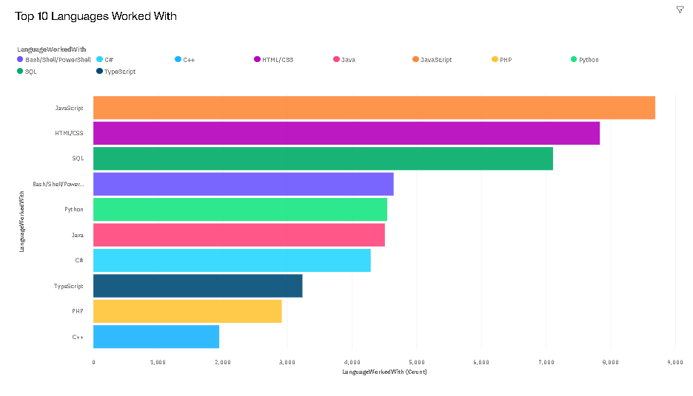
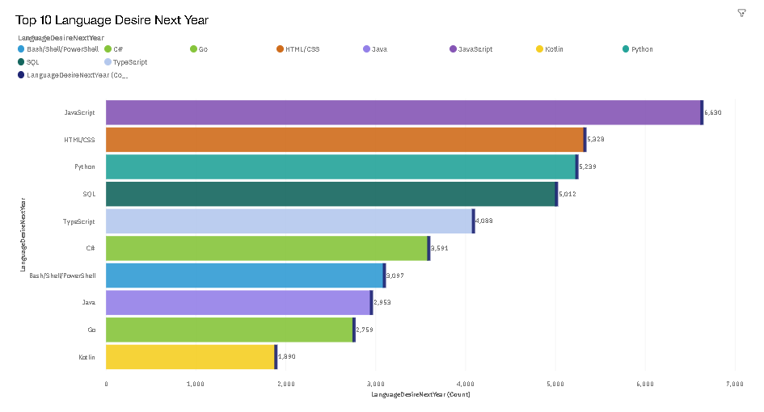
PROGRAMMING LANGUAGE TRENDS
Current Year
Next Year

Slide 8
PROGRAMMING LANGUAGE TRENDS - FINDINGS & IMPLICATIONS
Findings
JavaScript is the most popular language currently as well as in the future.
HTML/CSS are the second most popular languages.
SQL and Python are seeing a positive trend in popularity and demand.
Implications
JavaScript and HTML/CSS are in demand currently and will be in the future.
Python’s is becoming one of the most in-demand programming languages.
Languages such as C#, C++, and Java are becoming less and less in-demand.

Slide 9
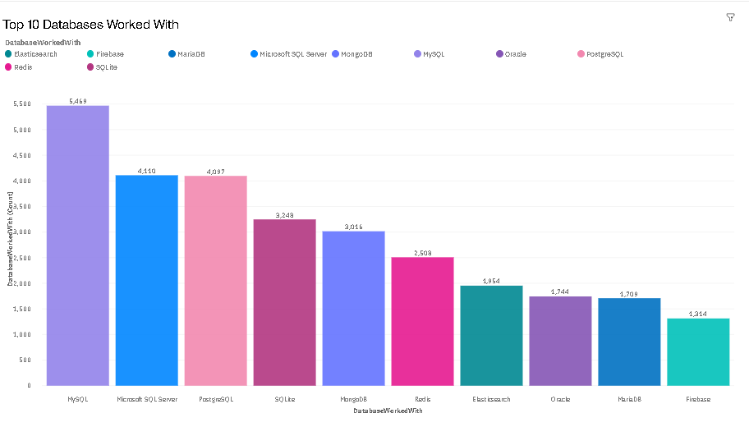
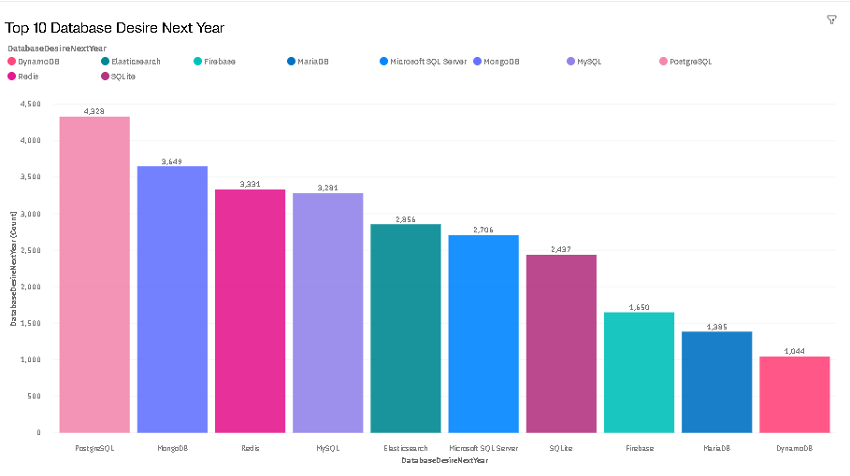
DATABASE TRENDS
Current Year
Next Year

Slide 10
DATABASE TRENDS - FINDINGS & IMPLICATIONS
Findings
Non-RDBMS like PostgreSQL and MongoDB are trending upwards in demand for the future.
Standard RDBMS are losing popularity, however, they are the most in-demand currently.
PostgreSQL looks like it will be the most desired non-relational database in the future
Implications
Non-relational databases could be utilized more than the current DBMS
Big data is becoming more and more important and more desired in the upcoming year according to the survey

Slide 11

DASHBOARD
https://dataplatform.cloud.ibm.com/dashboards/1b686e1f-6469-4d50-a578-db89043f1e6a/view/7563d01b67f102910de3eee4079025507b35260ee3bb815189837b495a627297f3684193c87a4b52d2455362a6e8105c9a

Slide 12
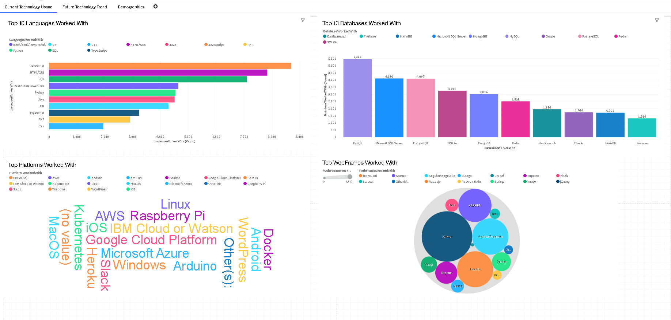
DASHBOARD TAB 1

Slide 13
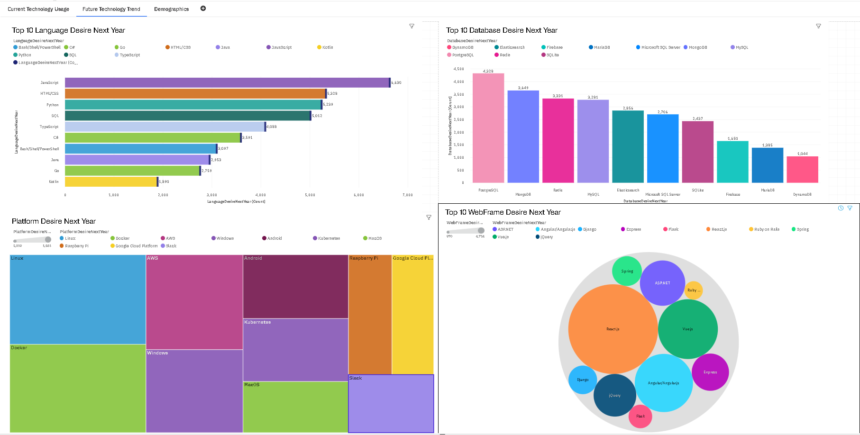
DASHBOARD TAB 2

Slide 14
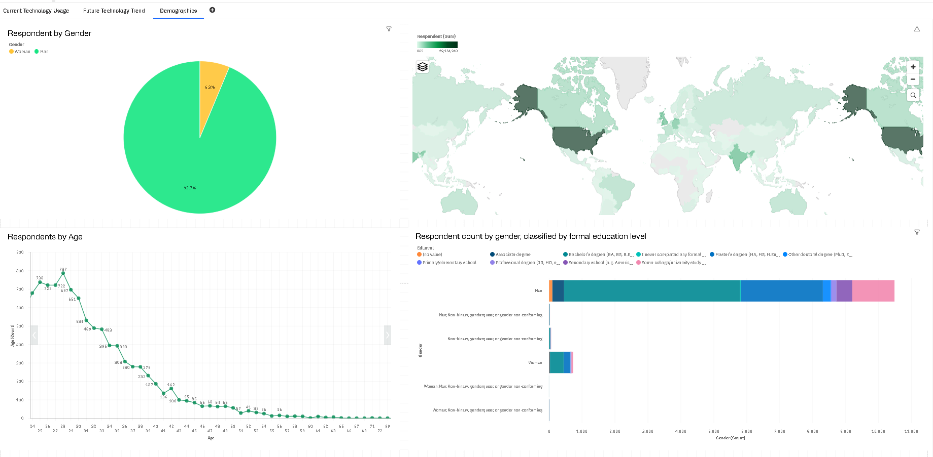
DASHBOARD TAB 3

Slide 15
DISCUSSION

Slide 16
OVERALL FINDINGS & IMPLICATIONS
Findings
JavaScript and HTML/CSS are the most popular languages currently as well as the future.
MySQL, Microsoft SQL Server and PostgreSQL are the most popular databases currently, however, PostgreSQL and MongoDB are expected to be the most in-demand in the future.
The top WebFrame currently is jQuery, however, React.js is expected to be the most in-demand in the future.
Python and SQL are trending upwards in popularity
Most of the respondents for this survey were males aged 22 – 40.
Implications
JavaScript and HTML/CSS will continue to be the most dominant programming languages.
Python and SQL are gaining steam while other languages like C# and C++ are losing steam
Webframe and database demand is experiencing change and some pair better with some languages than others.

Slide 17

CONCLUSION
If one wants to be a programmer it is best to familiar with multiple languages like JavaScript, HTML/CSS, Python, and SQL, as well as multiple databases and WebFrames.
A working knowledge of RDBMS as well as non-RDBMS is preferred.
The more well-rounded one is the better.
If you want to succeed then learn to love learning because technology is always changing.

Slide 18

APPENDIX
Include any relevant additional charts, or tables that you may have created during the analysis phase.

Slide 19
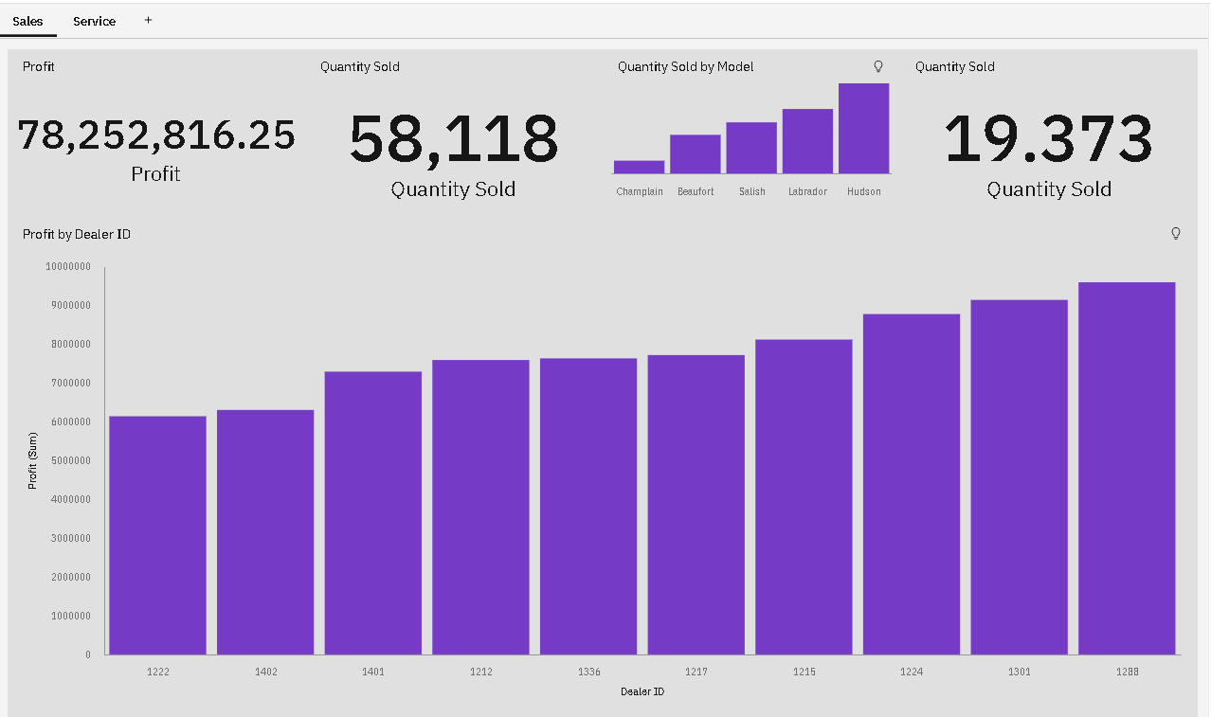
Auto Sales

Slide 20
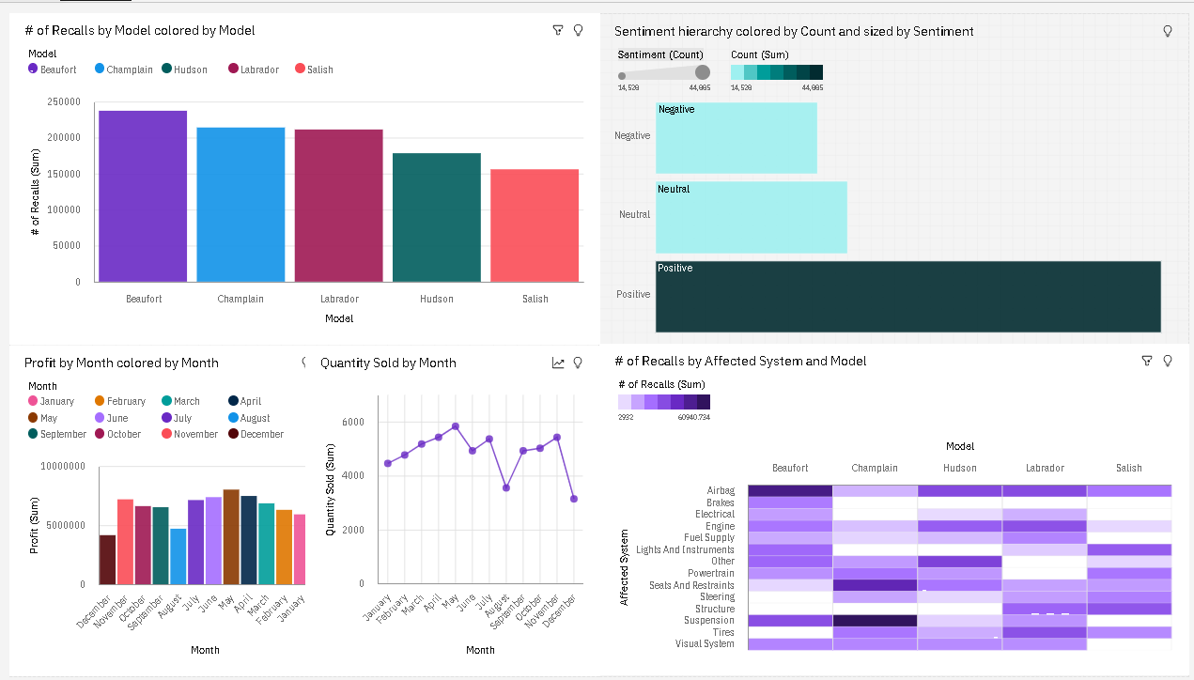
Auto Service

Slide 21
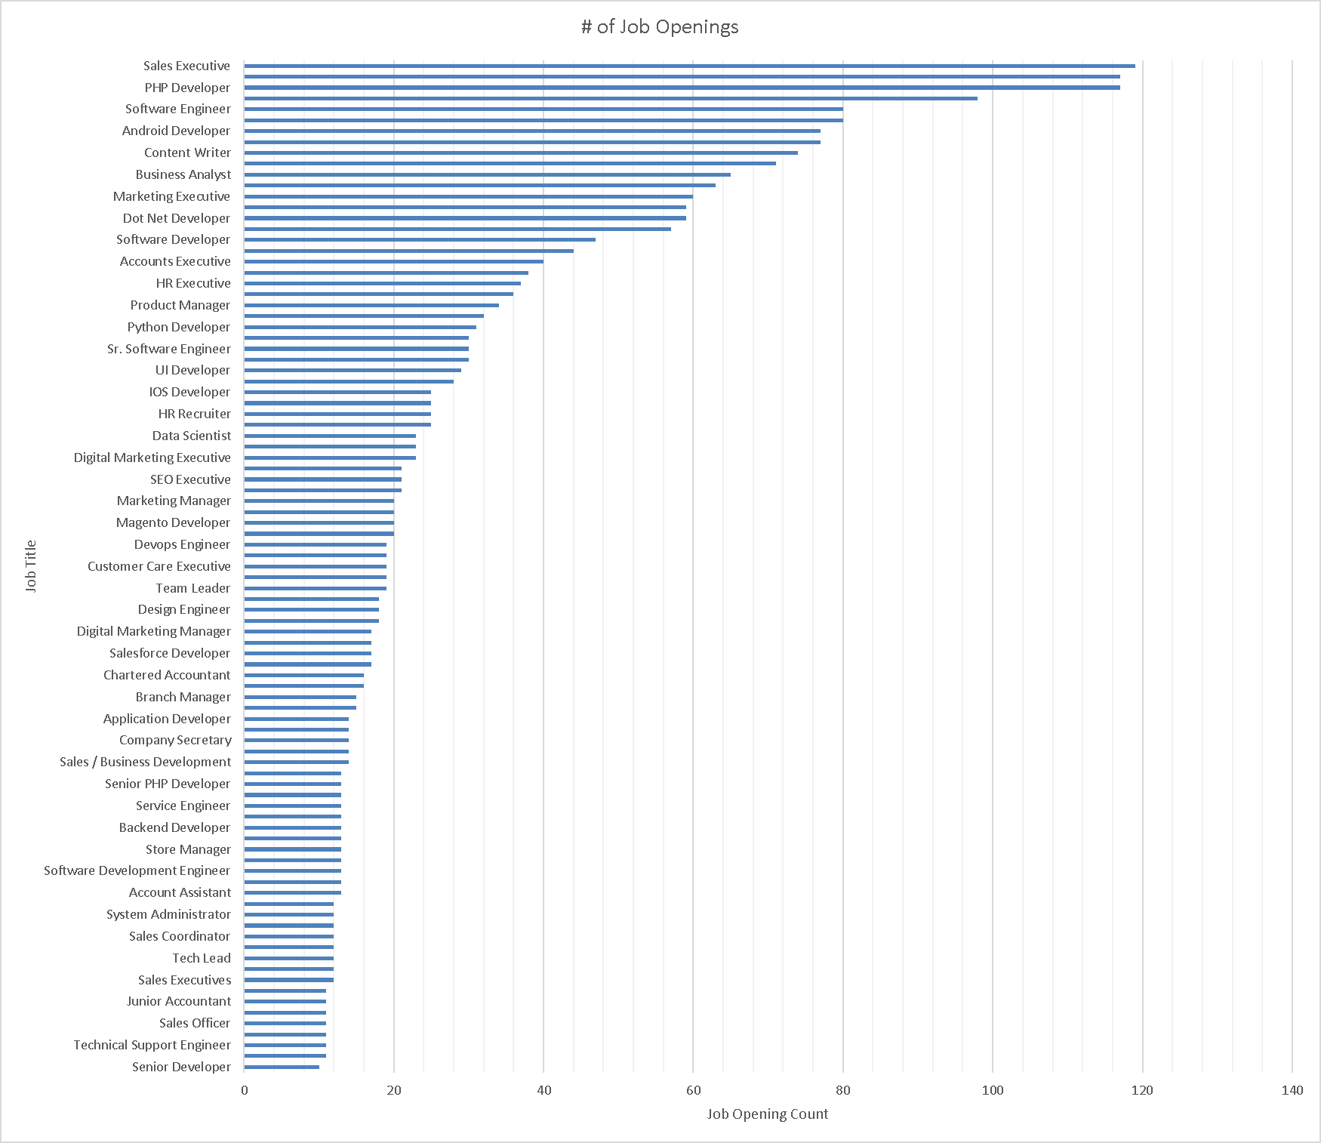
GITHUB JOB POSTINGS

Slide 22
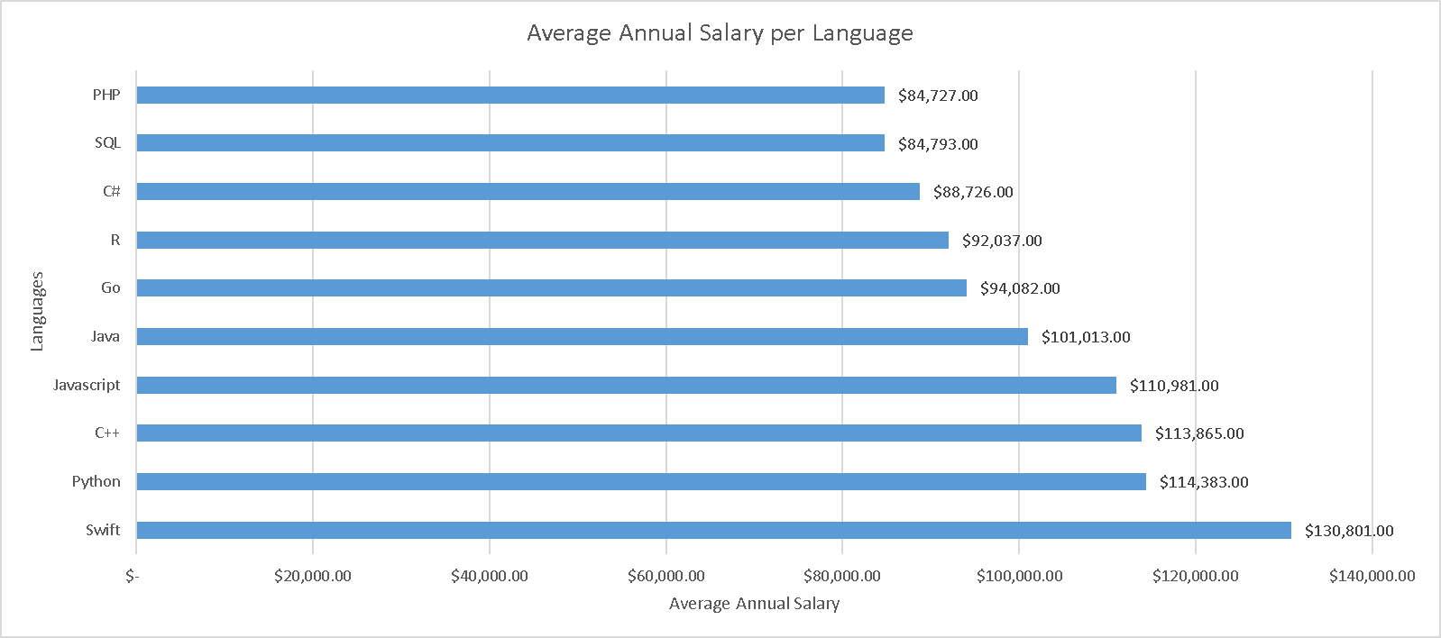
POPULAR LANGUAGES

